Slide 1

Object Oriented Programming
UNIT :- III
Methods and Inheritance in JAVA

Slide 2
Important Topic
Abstract Class and Method
Array, Multi Dimensional Array
Strings
Wrapper Classes
JAVA Enum
Inheritance in Java
The Super Keyword in Java, Constructors
Method Overriding
Multilevel Inheritance
Dynamic method dispatch
Using final with inheritance

Slide 3
Arrays and Strings

Slide 4
Outline
Introduction to Java array
One-dimensional array- creation
Two-dimensional array
Introduction to Java String
Declaration and creation
Different String methods
String array

Slide 5
Introduction to Java Array
It is a collection of related data items, that share a common name
Also called subscripted variable.
So complete set of values of similar type is referred to as an Array, whereas the individual values are called elements.
Purpose of array is to make program more concise and efficient, this is because array has ability to represent collection of related item, and to refer to an item it has unique subscript or index.
Remember array index can be integer constant, integer variable or expression that yield integer value.

Slide 6
Creating an Array(1D)
Creation of array involves three steps:
1. Declaring the array
2. Creating memory locations
3. Putting values into the memory locations(initialization)

Slide 7
Declaring the array
Arrays in Java may be declared in two ways;
form1:
type arrayname[];
form2:
type [] arrayname;
Examples
int marks[];
float percentage[];
int [] number;
Remember, we do not enter the size of the array in the declaration.

Slide 8
Creating memory locations
For creation of array, Java allows us to use new operator.
arrayname = new type[size];
Example:
number = new int[5];
average = new float[6];
This step allocates required space for array, here in example array number and average are of type integer and float resp., so number refers to array of five integers and average refers to array of six floating point values.
It is possible to combine the steps of declaration and creation of array as;
int number[ ] = new int[5];

Slide 9
Initialization of Arrays
Process of assigning values to array elements is called initialization
Syntax
arrayname [subscript]= value;
We can also initialize array at the time of its declaration.
int number[]={1,2,3,4,5};
We can also use for loop to initialize the array.

Slide 10
Scanner input =new Scanner(System.in);
int x[]=new int [5]; //Declare and create an array
System.out.println(“Define the size of array”);
int n=input.nextInt(); //Define a size of an array
System.out.println(“Enter the array elements”);
for(int i=0;i<n;i++) // Initialize the array elements
{
x[i]=input.nextInt();
}
System.out.println(“Display the array elements”);
for(int i=0;i<n;i++) // Display the array elements
{
System.out.println(“x[”+i+”]=”+x[i]);
}

Slide 11
Array Length
In Java, all the array store the allocated space(size) in a variable called length.
To get the length of array we have syntax;
int variable_name=arrayname.length;
Example:
int number[]=new int [5];
int a= number.length;
then, 5 value is value assigned to integer variable a.

Slide 12
Two Dimensional Array
2D Arrays in Java declare and create in two ways;
form1:
type arrayname[][];
arrayname=new int[size][size];
form2:
type arrayname [][]=new int[size][size];
Examples
int marks [] [] = new int[3][4];
int table [2][3]= {0,0,0,1,1,1};
int table [2][3]= {{0,0,0},{1,1,1}};
Remember, we do not enter the size of the array in the declaration.

Slide 13
Strings- Introduction
Strings represent sequence of characters.
The easiest way of strings representation in Java is by using character Array.
Example:_ char charArray[]=new char[4];
charArray[0]=‘J’;
charArray[1]=‘A’;
charArray[2]=‘V’;
charArray[3]=‘A’;
Character array do not support the range of operations we may like to perform on strings

Slide 14
Strings
In Java, strings are class objects and implemented by using two class namely, String and StringBuffer.
In Java, we have in built class String.
So, Java strings are the objects of class String.
Objects of string are immutable which means a constant and cannot be changed once created.

Slide 15
Creating a Strings
There are two way to create a sting in JAVA
1) String Literals
String s= “PICT”;
2) By using new Keyword

Slide 16
Declaration and Creation using new Keyword
Syntax for Java string declaration and creation is,
String stringname;
stringname = new String (“ string ”);
These two statements may be combined as follows;
String stringname = new String (“ string ”);
Here String is the inbuilt class and stringname is the object of that class.
Example
String name= new String(“PICT”);
declaration
creation

Slide 17
String Methods
How to call Method | Task performed by method
s1.equalsIgnoreCase(s2) | Returns true if s1=s2,ignoring the case of characters
s1.equals(s2) | Returns ‘true’ if s1 is equal to s2
s1.length() | Gives length of string s1
s1.compareTo(s2) | Returns negative if s1<s2, positive if s1>s2, and zero if s1 is equal to s2
s2=s1.toLowerCase; | Converts all the elements of string s1 to lowercase
s2=s1.toUpperCase; | Converts all the elements of string s1 to uppercase
s2=s1.replace(‘A’,’B’); | Replace all appearances of element ‘A’ by ‘B’
s1.concat(s2) | Concatenates s1 and s2

Slide 18
String Constructors
String (char [] chars):- Allocates a new string from the given character array
e.g. char chars[]={‘P’,’I’,’C’,’T’};
String s =new String(chars);
String(char[] chars, int start_Index, int numChars):- Allocates the string from given character array but choose count characters from start index.
e.g. char chars[]={‘P’,’I’,’C’,’T’};
String s=new String(chars, 1,3);
String(byte ascii[]):- Construct the new string by decoding the byte array
e.g. byte ascii[]={65,66,67,68,69,70};
String s=new String(ascii);
String(byte ascii[],int start_index,int length):- Construct the new string from the byte array depending on the start index and length
e.g. . byte ascii[]={65,66,67,68,69,70};
String s=new String(ascii,2,3);

Slide 19
String Array
We can also create and use arrays that contains strings as an elements.
Syntax
String array_name[]=new String[size];
Example:
String department [ ] = new String[5];
this statement will create, department of size 5 to hold five string constants.

Slide 20
Assignment no. 5
Write Programs in Java to sort
i) List of integers
ii) List of names.
The objective of this assignment is to learn Arrays and Strings in Java

Slide 21
Assignment no. 6
Write Programs in Java to add two matrices.
The objective of this assignment is to learn two dimensional Arrays in Java

Slide 22
String Buffer
StringBuffer supports to modifiable string.
As you know, String represents fixed length, immutable character sequence.
In contrast, StringBuffer represents growable and writable character sequences.
StringBuffer may have characters and substrings inserted in the middle or appended to the end

Slide 23
StringBuffer Constructors
StringBuffer():- It reserves room for 16 characters without reallocation
e.g. StringBuffer s =new StringBuffer();
StringBuffer(int size):- Allocates Accepts an integer argument that explicitly sets the size of the buffer
e.g. StringBuffer s =new StringBuffer(20);
StringBuffer(String str):- :- It accepts a string argument that sets the initial contents of the StringBuffer object and reserves room for 16 more characters without reallocation.
e.g. StringBuffer s=new StringBuffer(“PICT”);

Slide 24
Methods | Action Performed
append() | Used to add text at the end of the existing text.
length() | The length of a StringBuffer can be found by the length( ) method
capacity() | the total allocated capacity can be found by the capacity( ) method
charAt() | specifies the index of the character being obtained
delete() | Deletes a sequence of characters from the invoking object
deleteCharAt() | Deletes the character at the index specified by loc
ensureCapacity() | Ensures capacity is at least equals to the given minimum.
insert() | Inserts text at the specified index position
length() | Returns length of the string
reverse() | Reverse the characters within a StringBuffer object
replace() | Replace one set of characters with another set inside a StringBuffer object

Slide 25
StringBuilder
StringBuilder in Java represents a mutable sequence of characters.
String Class in Java creates an immutable sequence of characters, the StringBuilder class provides an alternative to String Class, as it creates a mutable sequence of characters.
The function of StringBuilder is very much similar to the StringBuffer class, as both of them provide an alternative to String Class by making a mutable sequence of characters.
StringBuilder class differs from the StringBuffer class on the basis of synchronization. The StringBuilder class provides no guarantee of synchronization whereas the StringBuffer class does.
StringBuilder more faster than StringBuffer

Slide 26
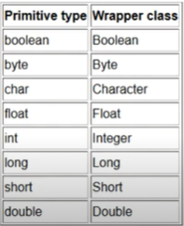
Wrapper Class
Def:- Wrapper class are predefined class by JAVA which can contain the primitive data type.
We can wrap a primitive values to wrapper class object.

Slide 27
Wrapper Class Method
PARSE : It is a method which take a string(input) as an argument and convert in other formats as like :
1.Integer
2.Float
3.Double
THE TYPES OF PARSE METHODS :
1.parseInt();
2.parseDouble();
3.parseFloat();

Slide 28
Syntax: ParseInt()
Integer.parseInt(String s);
Float.parseFloat(String s);
Double.parseDouble(String s);
Example1:
String s=”156″; //156 is not a number it is string; System.out.println(s+1); //output:1561 :”156″+1=1561 string concatenation.
int x=Integer.parseInt(“156”);
System.out.println(x+1); //output:157 :156+1=157

Slide 29
Autoboxing and Unboxing
Autoboxing:- It is automatic conversion that JAVA makes between the primitive data types to corresponding object wrapper class.
Unboxing:- when we convert object of wrapper class to respective primitive data types.

Slide 30
When to use
While using collection framework
To convert primitive data type to objects and vice versa
Many libraries in java deals with objects not with primitive data type

Slide 31
Fundamental of JAVA Programming
Inheritance in JAVA

Slide 32
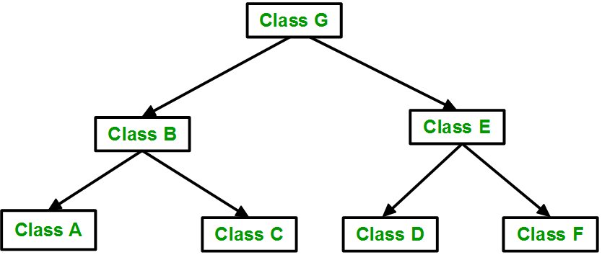
Inheritance Concept
Inheritance is a fundamental concept of Object Oriented Programming
Mechanism of deriving a new class from an old one is called as Inheritance
Java classes can be reused by creating new classes i.e. reusing the properties of existing ones
Base Class-Superclass
Class Student
- name: String
- DOB: Date
Class FE
- ID No.: int
- Address: String
Class SE
- ID No.: int
- Address: String
Child Class:-subclass
Child Class:-subclass

Slide 33
Inheritance Concept
Base Class-Superclass
A class can be defined as a "subclass" of another class.
The subclass inherits all data attributes of its superclass
The subclass inherits all methods of its superclass
The subclass inherits all associations of its superclass
The subclass can:
Add new functionality
Use inherited functionality
Override inherited functionality
Class Student
- name: String
DOB: Date
Void getdata();
Void display()
Class FE
- ID No.: int
Address: String
void marks();
Void display();
Class SE
- ID No.: int
Address: String
void marks();
Void display();
Child Class:-subclass
Child Class:-subclass

Slide 34
Inheritance Concept
Superclass
Subclass
Superclass
Employee
name = "John Smith"
dob = Jan 13, 1954
employeeID = 37518
salary = 65000
startDate = Dec 15, 2000
Person
- name: String
- dob: Date
Person
name = "John Smith"
dob = Jan 13, 1954
is a kind of
Employee
- employeeID: int
- salary: int
- startDate: Date
Advantages of Inheritance
To use existing functionality
Override existing functionality
Provide new functionality
Combination of existing and new functionality
Subclass

Slide 35
Inheritance Syntax (Defining a subclass)
The Extends keyword is used to define a new class that derives from an existing class.
The meaning of “extends” is to increase the functionality.
class Person
{
private String name;
private Date dob;
[...]
class <subclass_name> extends <superclass_name>
{ //Data and methods in this sublass
}
Person
- name: String
- dob: Date
class Employee extends Person
{
private int employeID;
private int salary;
private Date startDate;
[...]
Employee
- employeeID: int
- salary: int
- startDate: Date
Employee anEmployee = new Employee();

Slide 36
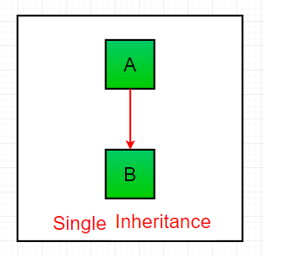
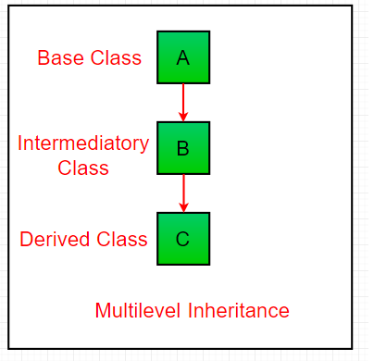
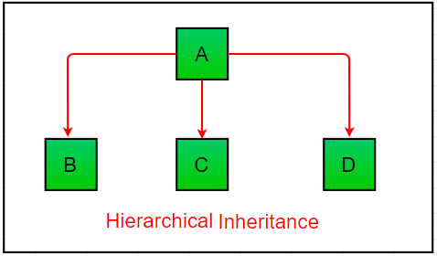

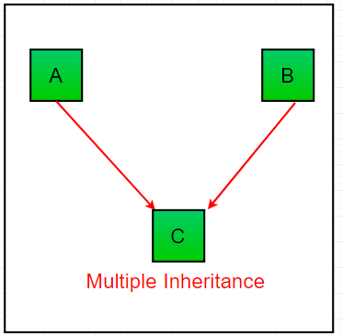
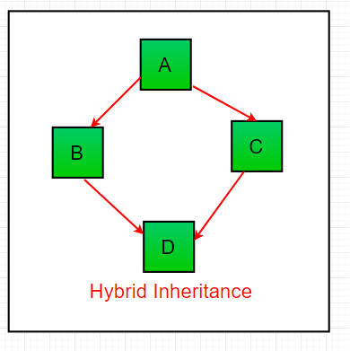

Types of Inheritance

Slide 37
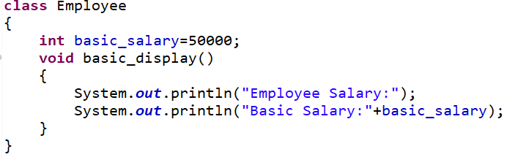
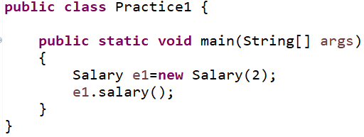
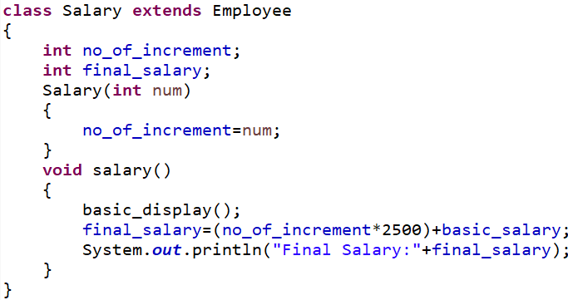

Single Inheritance Example
Employee
- basic_salary
basic_display()
Salary
no_of_increment
Salary();
salary();

Slide 38
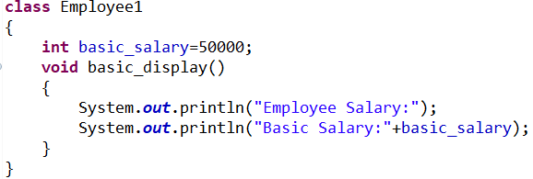
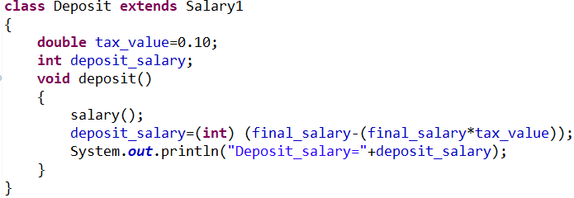
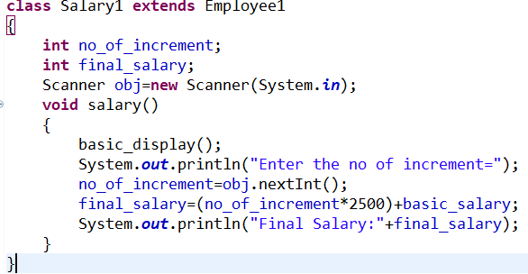
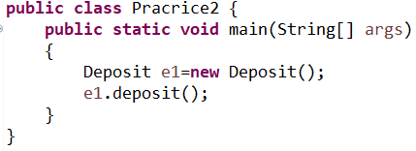
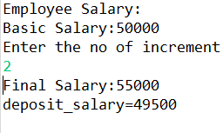
MultiLevel Inheritance Example

Slide 39
Hierarchical Inheritance Example

Slide 40


Multilevel Inheritance Example
import java. util. Scanner;
Class A
{
int x;
Scanner in=new Scanner(System.in);
void get_data()
{
System.out.println(“Enter the value of x:-”);
x= in.nextInt();
System.out.println(“x=”+x);
}
}
Class B extends A
{
int y;
void enter_data()
{
System.out.println(“Enter the value of y:-”);
y= in.nextInt();
System.out.println(“y=”+y);
}
Void display()
{ System.out.println(“x+y=”+(x+y));
}
}
Class C extends B
{
int z;
void put_data()
{
System.out.println(“Enter the value of z:-”);
z= in.nextInt();
System.out.println(“z=”+z);
}
Void display1()
{ System.out.println(“x+y+z=”+(x+y+z));
}
}
class Multilevel
{
public static void main(String args[])
{
C subobj1=new C();
subobj1.get_data();
subobj1.enter_data();
subobj1.display();
subobj1.put_data();
subobj1.display1();
}
}
Output:- Enter the value of x:- 2
x=2
Enter the value of y:-3
y=3
x+y=5
Enter the value of z:- 7
z=7
x+y+z=12

Slide 41
Method Overriding Concept
Declaring a method in a subclass which is already present in the parent class is known as Method Overriding
In this case the method in parent class is called as overridden method and method in the subclass is called as overriding method.
Usage of JAVA Method Overriding :-
Method overriding is used to provide the specific implementation of a method which is already provided by its superclass
Method overriding is used for runtime polymorphism
Rules:-
The method must have the same name as in the parent class.
The method must have the same parameter as in the parent class.

Slide 42
Method Overriding Example
import java. util.Scanner;
Class A
{
int x;
Scanner in=new Scanner(System.in);
void get_data()
{
System.out.println(“Enter the value of x:-”);
x= in.nextInt();
System.out.println(“x=”+x);
}
}
Class B extends A
{
int y;
void enter_data()
{
System.out.println(“Enter the value of y:-”);
y= in.nextInt();
System.out.println(“y=”+y);
}
Void display()
{ System.out.println(“x+y=”+(x+y));
}
}
Class C extends B
{
int z;
void put_data()
{
System.out.println(“Enter the value of z:-”);
z= in.nextInt();
System.out.println(“z=”+z);
}
Void display()
{ System.out.println(“x+y+z=”+(x+y+z));
}
}
class Multilevel
{
public static void main(String args[])
{
C subobj1=new C();
subobj1.get_data();
subobj1.enter_data();
subobj1.display();
subobj1.put_data();
subobj1.display();
}
}
Output:- Enter the value of x:- 2
x=2
Enter the value of y:-3
y=3
x+y=5
x+y+z=2+3+0=5
Enter the value of z:- 7
z=7
x+y+z=12

Slide 43
The Keyword Super
Super keyword in Java is a reference variable
super is used to access something (any protected,default or public field or method) from the super class that has been overridden
super.<variable_name> refers to the variable of parent class.
super() invokes the constructor of immediate parent class.
super.<method_name> refers to the method of parent class.

Slide 44
Super: Referring Super Class Instance Variables
class Animal
{
String color= “white”;
}
class Dog extends Animal
{
String color =“black”;
void printcolor()
{
System.out.println(color);
System.out.println(super.color);
}
}
class TestSuper1
{
public static void main(String args[])
{
Dog d =new Dog();
d.printcolor();
}
}
Output :- black
white

Slide 45
Super: Invoking Super Class Method
class Animal
{
String color= “white”;
void eat ()
{ System.out.println(“eating……”);
}
}
class Dog extends Animal
{
String color =“black”;
void printcolor()
{
System.out.println(color);
System.out.println(super.color);
}
void eat()
{
super.eat();
System.out.println(“eating bread….”);
}
}
class TestSuper1
{
public static void main(String args[])
{
Dog d =new Dog();
d.printcolor();
d.eat();
}
}
black
white
eating……..
eating bread……

Slide 46
Super: Invoking Parent Class Constructor
class Animal
{
Animal ()
{ System.out.println(“Animal color is white and eating……”);
}
}
class Dog extends Animal
{
Dog()
{
super();
System.out.println(“bread”);
}
}
class TestSuper1
{
public static void main(String args[])
{
Dog d =new Dog();
}
}
Animal colour is white and eating…….
bread

Slide 47
Super();
A subclass constructor is used to construct the instance variables of both the subclass and the superclass.
Purpose of super():
Subclass constructor uses the keyword super to invoke the constructor of superclass.
Conditions inorder to use super keyword inside subclass constructor:
1. super() may only be used within a subclass constructor method
2. The call to super class constructor must appear as the first statement within the subclass constructor
3. The parameters in the super() call must match the order and type of the instance variable declared in the super class

Slide 48
Assignment No.7
Write a program in Java to create a player class. Inherit the classes Cricket_player, Football_player and Hockey_player from player class. The objective of this assignment is to learn the concepts of inheritance in Java
Player
Cricket_player
Football_player
Hockey_player

Slide 49
import java.util.Scanner;
class Player
{
String name;
int age;
String gameName;
int noOfGamesPlayed;
String address;
String type;
Scanner in=new Scanner(System.in);
void getDetails()
{
System.out.println("Enter the details Name , Age, Address, Name of Game ,No of Games Played and Type ");
name=in.next();
age=in.nextInt();
address=in.next();
gameName=in.next();
noOfGamesPlayed=in.nextInt();
type=in.next();
}
void display()
{
System.out.println("Name : "+ name
+”Age: " + age
+" Game Name:"+ gameName
+ " Total Matches: " +noOfGamesPlayed
+" Address: "+ address
+" International or National : " +type );
}
}
Super Class

Slide 50
class Cricket_Player extends Player
{
int totalRuns;
int totalWickets;
void getDetails()
{
super.getDetails();
System.out.println("Enter the Total Runs and Wickets: ");
totalRuns=in.nextInt();
totalWickets=in.nextInt();
}
void display()
{
super.display();
System.out.println("Total Runs: " +totalRuns +" Total
Wickets :"+totalWickets);
}
}
Cricket Sub Class

Slide 51
class FootBall_Player extends Player
{
int noOfGoals;
void getDetails()
{
super.getDetails();
System.out.println("Enter the total no of Goals");
noOfGoals=in.nextInt();
}
void display()
{
super.display();
System.out.println("Total Goals: " +noOfGoals );
}
}
Football Sub Class

Slide 52
public class TenthAssignment
{
public static void main(String[] args)
{
Cricket_Player cp=new Cricket_Player();
cp.getDetails();
cp.display();
FootBall_Player fp=new FootBall_Player();
fp.getDetails();
fp.display();
}
}
Main Method

Slide 53
Dynamic Method Dispatch Concept
Dynamic method dispatch is a process in which a call to an overridden method is resolved at running time rather than compile time.
It is also called as runtime polymorphism .
Method overriding is resolved at runtime instead of compile time
That means choice of the version of the overridden method to be executed in response to method call is done at runtime.
In this process, an overridden method is called through the reference variable of superclass. But determination of the method to be called is based on the object being referred to by the reference variable.

Slide 54
class Super
{
public void method()
{
System.out.println(“Super Method”);
}
}
class Sub extends Super
{
public void method()
{
System.out.println(“Sub Method”);
}
}
class dyn_dis
{
public static void main(String args[])
{
Super A =new Super();
A. method();
Sub B=new Sub();
B. method();
Super C= new Sub();
//Sub’s object reference assigned Super type reference variable
C.method();
//Sub’s Version of method will be called at runtime
}
}
Dynamic Method Dispatch Example
Output:-Super Method
Sub Method
Sub Method

Slide 55
Final Keyword Concept
Final keyword in Java is used to restrict the access of an item from its super class to subclass
Using final to prevent overriding:-
methods declared as final cannot be overridden
variable cannot be access in subclass
Using final to prevent inheritance:-
class declared as final cannot be inherited
Hey, I am final !
You can not change my value
You can not override me
You can not inherit me

Slide 56
Abstraction in Java
Abstraction in Java
Abstraction is a process of hiding the implementation details and showing only functionality to the user.
It shows only important things to the user and hides the internal details
Ex: sending SMS.
Abstraction lets you focus on what the object does instead of how it does it.

Slide 57
Abstract Class in Java
A class that is declared as abstract is known as abstract class
It can have abstract and non-abstract methods (method with the body).
It needs to be extended and its method implemented. It cannot be instantiated.
Ex:
abstract class A
{
}
abstract method: A method that is declared as abstract and does not have implementation is known as abstract method.(i.e. method with the body only without it’s definition)
Ex: abstract void print_Status();

Slide 58
Rules about Abstract Classes
An abstract class must be declared with an abstract keyword
It can have abstract & non abstract method
It can not be instantiated (i.e object of that class can not be created)
It can have constructors & static methods also.
It can have final method which will force the subclass not to change the body of the method.

Slide 59
Abstract Method
A method which is declared as abstract and does not have implementation is known as an abstract method.
E.g. abstract void printStatus();//no method body and abstract

Slide 60
Example of Abstract Class that has Abstract Method
abstract class Bike
{
abstract void run();
}
class Honda extends Bike
{
void run()
{
System.out.println("running safely..");
}
}
public class Test {
public static void main(String args[])
{
Bike obj = new Bike();
Bike obj = new Honda();
obj.run();
}
}
Output:- running safely

Slide 61
Example of Abstract Class that has Constructor, Abstract Method
abstract class Bike
{
Bike()
{
S.o.p(“Bike Starts”);
}
abstract void run();
void changeGear()
{
S.o.p(“Gear Changed”);
}
}
class Honda extends Bike
{
void run()
{
System.out.println("running safely..");
}
}
public class Test {
public static void main(String args[])
{
Bike obj = new Honda();
obj.run();
obj.changeGear();
}
}
Output:-Bike Starts
Running Safely
Gear Changed

Slide 62
Packages
Java two most innovative features are packages and Interfaces
Package is the set of collection of classes and / or interfaces
It act as a container for classes that are used.
Why Packages ?
Limitation to reusing the classes within a program
If we need to use classes from other programs without physically copying them into the program under development?

Slide 63
Advantages of Packages
Code Reusability :- Because package contain the group of classes (i.e Reusability and Maintainability)
Resolving Name Collision :- when multiple packages have classes with the same name
Package also provides the hiding of class facility (i.e other programs can not use the class from hidden packages)
Access Limitation can be applied with the help of package
Nesting of package

Slide 64
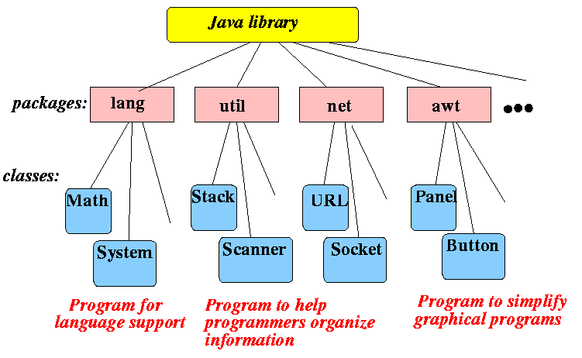
Packages
In Java, already many predefined packages are available those are to help programmers to develop their software in any easy ways.
E.g. java.swing ,java.lang-
All build in package are bundle called API bundled with the JDK

Slide 65
Simple example of java package
package mypack;
public class Simple
{
public static void main(String args[])
{
System.out.println("Welcome to package");
}
}

Slide 66
How to access package from another package?
There are three ways to access the package from outside the package.
1. import package.*;
2.import package.classname;
3.fully qualified name.

Slide 67
Usingpackagename.*
File Name:-A.java
File Name:-B.java
package pack;
public class A
{
public void msg()
{
System.out.println("Hello");
}
}
package mypack;
import pack.*;
class B
{
public static void main(String args[])
{
A obj = new A();
obj.msg();
}
}

Slide 68
Using packagename.classname
File Name:-A.java
File Name:-B.java
package pack;
public class A
{
public void msg()
{
System.out.println("Hello");
}
}
package mypack;
import pack.A;
class B
{
public static void main(String args[])
{
A obj = new A();
obj.msg();
}
}

Slide 69
Using fully qualified name
File Name:-A.java
File Name:-B.java
package pack;
public class A
{
public void msg()
{
System.out.println("Hello");
}
}
package mypack;
import pack.A;
class A
{
public static void main(String args[])
{
A obj = new A();
pack.A obj = new pack.A();
obj.msg();
}
}

Slide 70
Access Modifiers in java
There are 4 types of java access modifiers:
1.private
2.default
3.protected
4.public

Slide 71
Access Modifier
1) private access modifier
The private access modifier is accessible only within class.
2) default access modifier
If you don't use any modifier, it is treated as default by default. The default modifier is accessible only within package.
3) protected access modifier
The protected access modifier is accessible within package and outside the package but through inheritance only.
4) public access modifier
The public access modifier is accessible everywhere. It has the widest scope among all other modifiers

Slide 72
Access Protection
Access Modifier Access Location | Public | Protected | Default | Private
Same Class | Yes | Yes | Yes | Yes
Subclass in Same Package | Yes | Yes | Yes | No
Non Subclasses in same package | Yes | Yes | Yes | No
Subclass in Different Packages | Yes | Yes | No | No
Non Subclasses in Different packages | Yes | No | No | No

Slide 73
Multiple Inheritance
Java does not support multiple inheritance
Classes in Java can not have more than one superclass
E.g. class A extends B extends C
{
----------------
----------------
}
Is not permitted in Java
Large number of real life applications require the use of multiple inheritance
In C++ , implementation of multiple inheritance proves difficult and adds complexity to the language.
But Java provides an alternate approach known as interfaces to support the concept of multiple inheritance

Slide 74
Interface
Basically it is a kind of class
Like classes, interface contain methods and variables but with a major difference
Difference is that interfaces define only abstract methods and final fields
This means that interfaces do not specify any code to implement these methods and data fields contain only constants
Responsibility of the class that implements an interface to define the code for implementation of these methods.
Syntax for defining an interface is very similar to that for defining a class

Slide 75
Syntax for Interface
General form of an interface definition is
interface InterfaceName
{
variable declaration;
method declaration;
}
Interface is just keyword
Variables are declared as
static final type variablename= value;
Methods declaration will contain only a list of methods without any body statements
return type methodsname1 (parameter_list);
Intreface Area
{
final static float pi=3.142F;
float comput ( float x, float y);
void show();
}

Slide 76
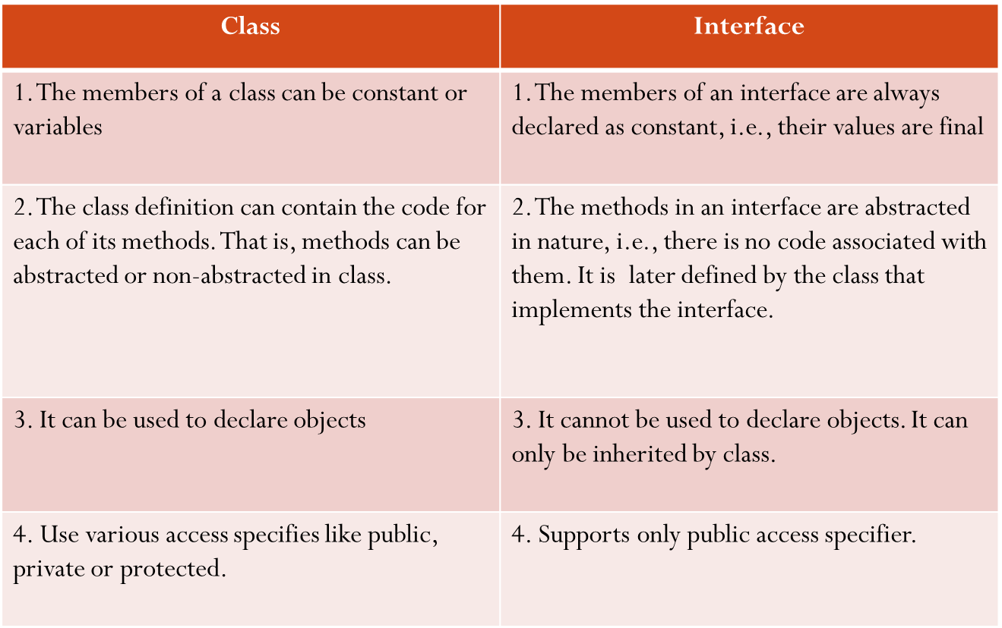
Difference Between Class and Interface

Slide 77
Extending Interface
As like classes, we can apply reusability concept on existing interface to create new interface.
That is, an interface can be sub-interfaced from existing interface.
So this existing interface is called superinterface.
The new subinterface will inherit all the characteristics of superinterface in the manner similar to subclass.
Syntax for this is:
interface name2 extends name1
{
body of name2;
}

Slide 78
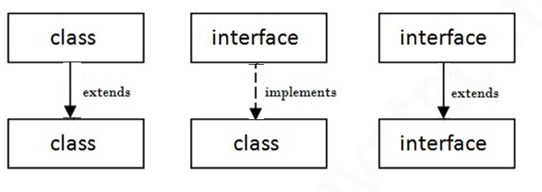
Extending Interface
interface Itemconstants
{
int code=1001;
string name=“Fan”;
}
interface Item extends ItemConstants
{
void display();
}
interface Itemconstants
{
int code=1001;
string name=“Fan”;
}
interface ItemMethods extends ItemConstants
{
void display();
}
Interfaces Item extends ItemConstants,ItemMethods
{
----------------
-----------------
}

Slide 79
Implementing Interfaces
Interfaces are used as “Superclasses” whose properties are inherited by classes.
Therefore necessary to create a class that inherits the given interface
Class classname implements interfacename
{
Body of classname
}
Class classname extends superclass
implements interfacename1,interfacename2,……..
{
Body of classname
}

Slide 80
Various forms of Interface Implementation
A
B
C
Interface
Implementation
Class
Extension
Class

Slide 81
Various forms of Interface Implementation
A
B
C
Interface
Implementation
Class
Extension
Class

Slide 82
Default Method in Interface
interface Drawable
{
void draw();
default void msg()
{
s.o.p("default method");
} }
class Rectangle implements Drawable
{
public void draw()
{s.o.p("drawing rectangle");
} }
class TestInterfaceDefault{
p.s.v.m.(String args[])
{
Drawable d=new Rectangle();
d.draw();
d.msg();
}
}

Slide 83
Static Method in Interface
interface Drawable
{
void draw();
static int cube(int x)
{return x*x*x;}
}
class Rectangle implements Drawable
{
public void draw()
{
s.o.p("drawing rectangle");
}
}
class TestInterfaceStatic
{
psvm(String args[])
{
Drawable d=new Rectangle(); d.draw();
s.o.p( Drawable.cube(3) );
}
}

Slide 84
ABSTRACT CLASS | INTERFACE
1) Abstract class can have abstract and non-abstract methods. | Interface can have only abstract methods. Since Java 8, it can have default and static methods also.
2) Abstract class doesn't support multiple inheritance. | Interface supports multiple inheritance.
3) Abstract class can have final, non-final, static and non-static variables. | Interface has only static and final variables.
4) Abstract class can provide the implementation of interface. | Interface can't provide the implementation of abstract class.
5) The abstract keyword is used to declare abstract class. | The interface keyword is used to declare interface.
6) Example: public abstract class Shape{ public abstract void draw();} | Example: public interface Drawable{ void draw();}

Slide 85
Object Oriented Programming
UNIT :- VI
Exception Handling , Multithreading, File I/o, Applet

Slide 86
Types of Errors
Type of Error
Compile Time Error
Run Time Error

Slide 87
Compile Time Errors
All syntax errors will be detected and displayed by the Java compiler ,these errors are called as compile time errors.
Whenever the compiler displays an error, it will not create the .class file
It is necessary to fix all these errors before we can successfully compile and run the program
class Myclass
{
public static void main (String args [])
{
System.out.println(“Hello Java”)
}
}
Syntax error, insert ";" to complete BlockStatements

Slide 88
Reasons for Compile Time Errors
Missing Semicolons
Missing brackets in classes and methods
Misspelling of identifiers and keywords
Missing double quotes in string
Used of undeclared variables
Bad Reference to objects
Use of = in place of == operator

Slide 89
Run Time Errors
Sometime. A program may compile successfully creating the .class file but may not run properly.
Such programs may produce wrong results due to wrong logic or may terminate due to errors.
Most Run time Errors are
1)Dividing an Integer by Zero
2) Out of the bounds of an array
3)Store a value into an array of an incompatible type
4) Passing a parameter that is not in a valid range or value for method
Attempting negative size of an array
Converting invalid string to a number
Accessing a character that is out of bounds of a string

Slide 90
Run Time Error Example
class Myclass
{
public static void main (String args [])
{
int a=10;
int b=5;
int c=5;
int x=a/(b-c); //Division by zero
System.out.println(“ x=”+x);
int y=a/(b+c);
System.out.println(“y=”+y);
}
}
Java.lang.ArithmeticException: /by zero
At Myclass.main(Myclass.java:)

Slide 91
Exceptions
Exception is a condition that is caused by a run time error in the program.
When the Java interpreter encounters an error such as dividing an integer by zero, it creates an exception object and throws
If the exception object is not caught and handled properly, the interpreter will display an error message as shown in the output of program and will terminate the program.
If we want the program to continue with the execution of the remaining code, then we should try to catch the exception object thrown by the error condition and then display an appropriate message for taking corrective actions. This task is known as exception handling.
Find the problem (Hit the exception)
Inform that an error has occurred (throw the exception)
Receive the error information (catch the exception)
Take corrective actions (handle the exception)

Slide 92
Exception Type | Cause of Exception
ArithmaticException | Caused by math errors such as division by zero
ArrayIndexOutOfBoundException | Caused by bad array indexes
ArrayStoreException | Caused when a program tries to store the wrong type of data in array
FileNotFoundException | Caused by an attempt to access a nonexistent file
IOException | Caused by general I/O failures, such as inability to read from a file

